Slide 1
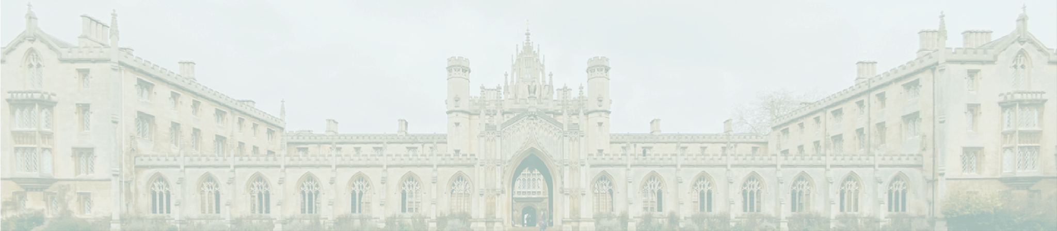

SPRING SEMESTER
2027 SCHEDULE
MON
TUE
WED
THU
FRI
INTRO TO
PSYCHOLOGY
ANCIENT CIVILIZATIONS
INTRO TO PSYCHOLOGY
INTRO TO ENV. ENGINEEING
Smith
Miller
Johnson
Johnson
1:00PM-3:00PM
2:00PM-5:00PM
1:00PM-3:00PM
12:30PM-3:00PM
PSY1002
BLG 4050
PSY1002
PSY1002
POLITICAL
SCIENCE 101
ANCIENT CIVILIZATIONS
ART HISTORY
Johnson
Smith
Miller
1:00PM-3:00PM
4:30PM-6:30PM
2:00PM-5:00PM
ART 2002
POL 340
BLG 4050

