Slide 1





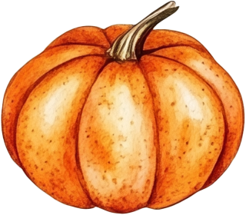



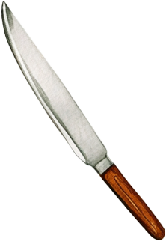






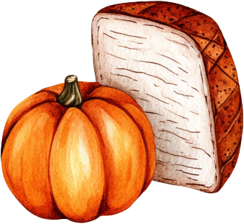
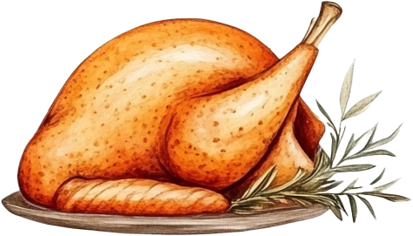


Dear Guest’s Name,
You’re invited to celebrate
Thanksgiving with the
Johnson family!
Thanksgiving
Feast
Date: Thursday, November 27
Time: 5:00 PM
Location: 123 Harvest Lane, Maple Town
Warm regards, The Johnson Family

