Slide 1





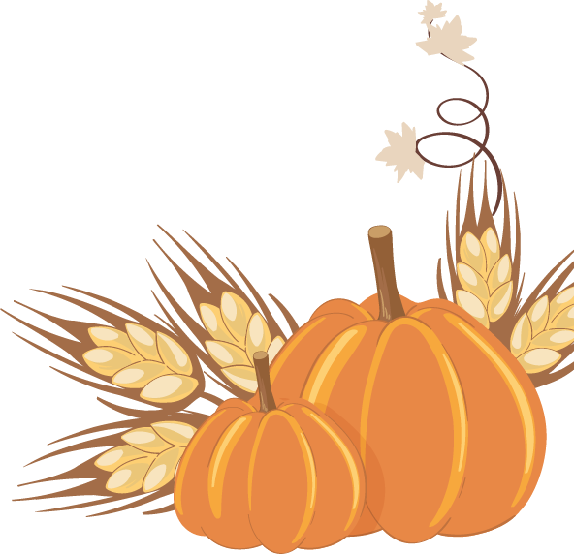



Thanksgiving
grocery list
meat
fruit
pantry
turkey
starberries
brown sugar
turkey legs
pineapple
ginger
chicken wings
cherries
flour
chicken legs
apples
cinnamon
ham
chickpeas
spices
sweets
other
paprika
marshmallow
orange juice
cumin
chocolate
water
lemon juice
cranberry
sauce
juice
butter
eggnog
pepper
carbonated
drinks

