Slide 1





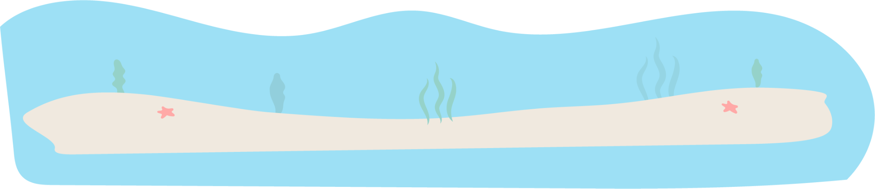
Summer
BUCKET LIST
Bike Ride
Play Swing Ball
Have a BBQ
Visit a Farm
Road Trip
Go to the Park
Go Fishing
Family Sleepover
Go to the Zoo
Movie Night
Read 8+ Books
Visit a Museum
Camp in the Backyard
Play Board Game
Go to the Beach
Go Pond Dipping
Catch Bugs
Have a Picnic
Fly a Kite
Have a Water Fight
Jump on a Trampoline
Walk for ice Cream
Walk for ice Cream
Go Fishing
Build a Sand Castle
Road Trip
Have a Water Fight
Bike Ride
Have a Picnic
Have a BBQ
Make Bird Feeders
Have a Water Fight
Collect Sea Shells
Climb Trees

