Slide 1



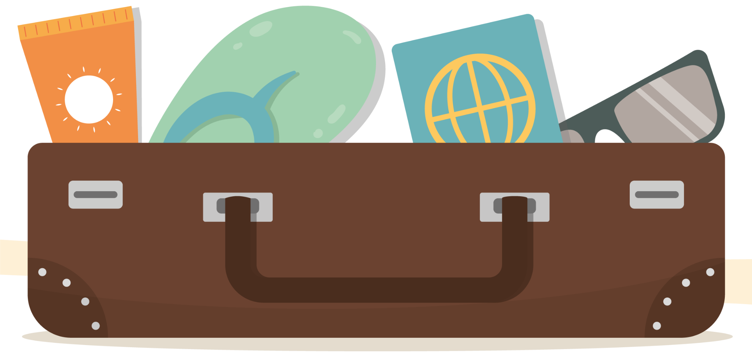
Beach Vacation
Packing List
Beach Gear:
Fun:
Clothes:
Umbrella
Beach Chair
Waterproof
Blanket
Beach Cart
Umbrella
Hooded Towel
Water wings
Mask
Water Toys
Beach toys or
games
Kites
Swimsuits
Shirt
Hats
Sandals
Water shoes
Flip flops
Toiletries:
Baby:
Food:
Shampoo
Conditioner
Bug spray
SPF Lip Balm
Anti-Itch Cream
Baby Powder
Face Wipes
Life Jacket
Spare Clothes
Hair Detangler
Cooler
Snacks
Water
Ice cream
Napkins

