Slide 1


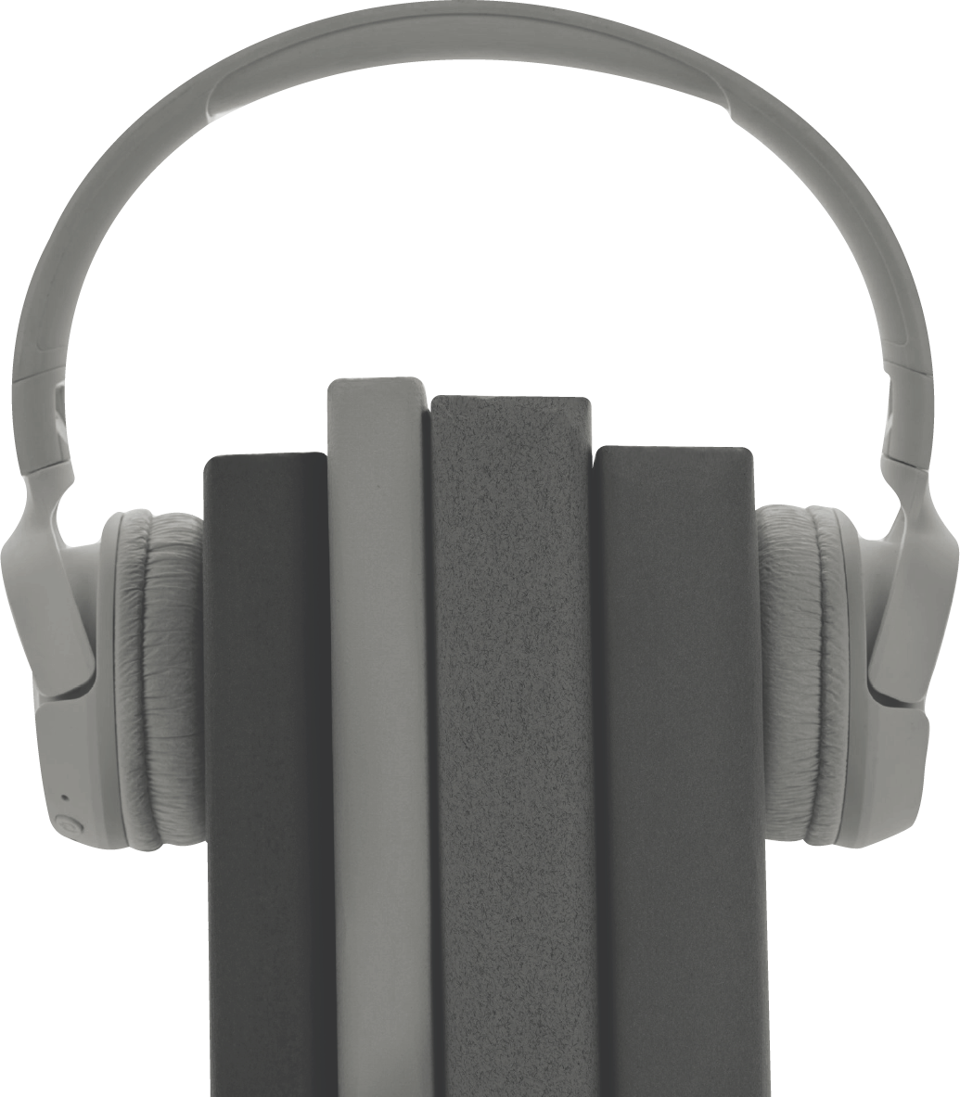

STUDENT INTEREST
Survey Template
How helpful or unhelpful is your academic advisor?
Extremely helpful
Moderately helpful
Slightly helpful
Neither helpful nor unhelpful
Slightly unhelpful
Moderately unhelpful
Extremely unhelpful
How easy or difficult is it to obtain the resources that you need from the university library system?
Extremely easy
Moderately easy
Slightly easy
Neither easy nor difficult
Slightly difficult
Moderately difficult
Extremely difficult

Slide 2


How useful are the services provided at the
on-campus career center?
Extremely useful
Very useful
Moderately useful
Slightly useful
Not useful at all
How helpful or unhelpful is the staff at the on-campus health center?
Extremely helpful
Moderately helpful
Slightly helpful
Neither helpful nor unhelpful
Slightly unhelpful
Moderately unhelpful
Extremely unhelpful
Overall, how satisfied or dissatisfied are you with your experience at this university?
Very dissatisfied
Dissatisfied
Somewhat dissatisfied
Neutral
Somewhat satisfied
Satisfied
Very satisfied

Slide 3


How safe or unsafe do you feel on campus?
Extremely safe
Moderately safe
Slightly safe
Neither safe nor unsafe
Slightly unsafe
Moderately unsafe
Extremely unsafe
How good or bad is the quality of the food served
at this university?
Extremely good
Moderately good
Slightly good
Neither good nor bad
Slightly bad
Moderately bad
Extremely bad
Overall, how well do the professors at this
university teach?
Extremely well
Very well
Moderately well
Slightly well
Not well at all

Slide 4
How easy or difficult is it to register for courses at
this university?
Extremely easy
Moderately easy
Slightly easy
Neither easy nor difficult
Slightly difficult
Moderately difficult
Extremely difficult
How reasonable or unreasonable is the cost of
courses/tuition at this university?
Extremely reasonable
Moderately reasonable
Slightly reasonable
Neither reasonable nor unreasonable
Slightly unreasonable
Moderately unreasonable
Extremely unreasonable
How well maintained are the facilities at this university?
Extremely well
Very well
Moderately well
Slightly well
Not well at all

Slide 5



How likely are you to attend this university next year?
Very unlikely
Unlikely
Somewhat unlikely
Undecided
Somewhat likely
Likely
Very likely
How likely are you to recommend this university to friends or colleagues?
Not at all likely
Extremely likely
0
1
2
3
4
5
6
7
8
9
10

