Slide 1

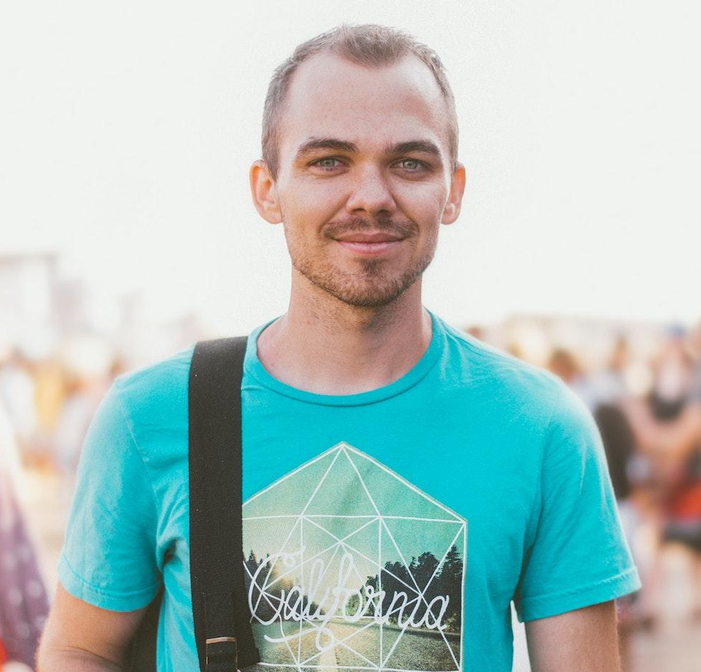

Anthony
Farekson
SPECIAL EDUCATION TEACHER
Dedicated and compassionate educator with over 10 years of experience working in both a kindergarten and school setting. Strong communication and organizational skills, with a passion for creating a positive and supportive learning environment for students.
Contact Information:
Phone: 555-555-5555
Email: anthony.farekson@email.com
Location: UK
Work Experience:
Skills:
Kindergarten Teacher
XYZ School, September 2016 - Present
• Education and instruction
• Classroom management
• Student assessment and evaluation
• Curriculum development
• Communication and interpersonal skills
• Microsoft Office and Google
Workspace
• Problem solving
• Storytelling voices
• Plan and implement lesson plans for a class of 20 students.
• Assess student progress and provide regular feedback to parents.
• Create a positive and inclusive classroom environment.
• Collaborate with colleagues to align curriculum with school-wide goals.
School Teacher
ABC School, September 2010 - August 2016
• Taught a variety of subjects including math, science, and English to students in grades 4-6.
• Developed and implemented engaging lesson plans.
• Assessed student progress and provided regular feedback.
• Participated in professional development opportunities and contributed to school-wide initiatives.
Education:
Interests
Bachelor of Education, University of Oxford (2010)
• Running
• Socialising
• Travelling
• Hiking
• Baking
Nulla eget libero vehicula eros consectetur egestas id vitae velit.
Donec quis mi auctor lectus accumsan consequat condimentum a dui.
Bachelor of Arts in English Literature, University of Cambridge (2008)
Nulla eget libero vehicula eros consectetur egestas id vitae velit.
Donec quis mi auctor lectus accumsan consequat condimentum a dui.
Certifications:
Referees
Teaching Certification, UK Department of
Education (2010)
Bell Raynor, Donec hendrerit
Phone: 555-555-5555

