Slide 1




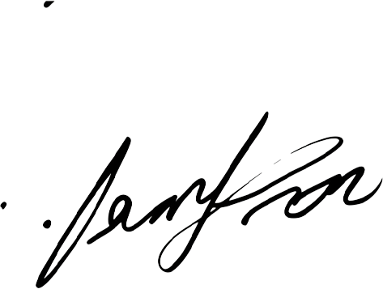
Central University
2025
S C H O L A R S H I P A W A R D
CERTIFICATE
This is to certify that
Ms. Emily Thompson
Has been awarded the Academic Excellence Scholarship for outstanding academic achievement, leadership, and commitment to excellence.
Awarded on this 23rd day of April, 2025.
DATE: APRIL 23, 2025
THE SCHOLARSHIP FOUNDATION

