Slide 1
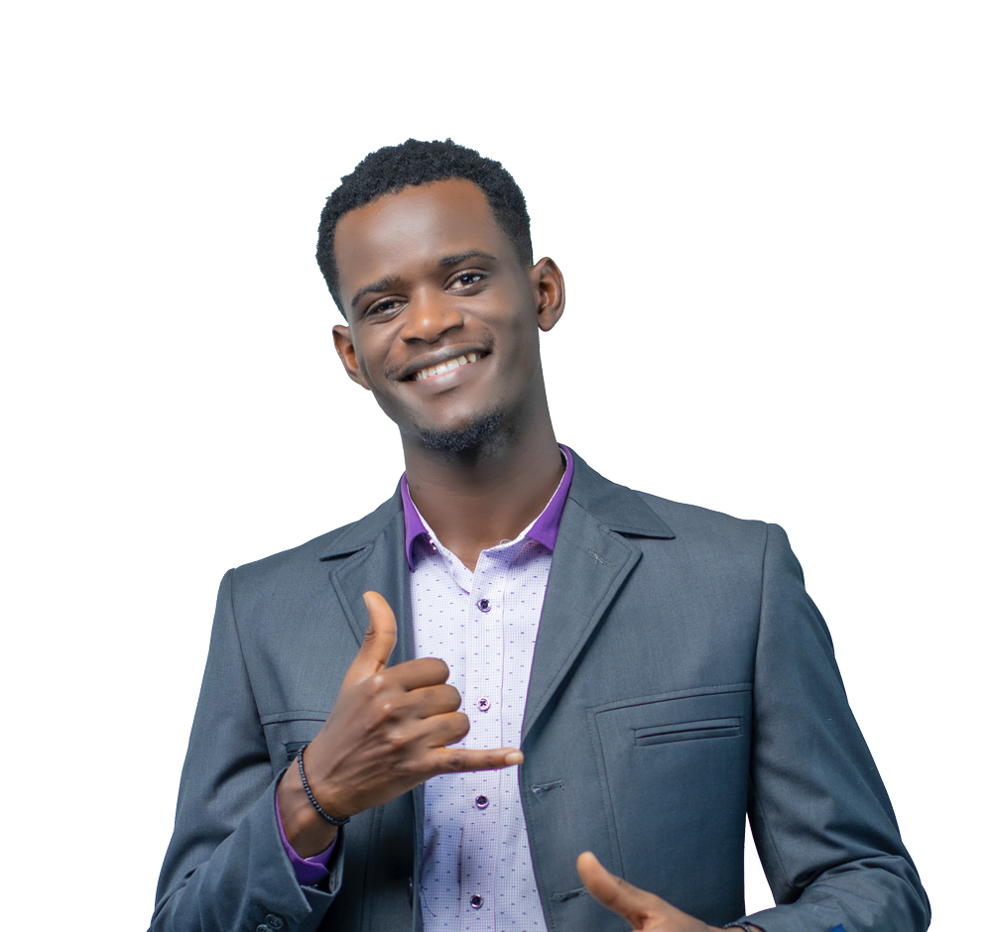
















MEET YOUR TEACHER
Mr. Deive
PAINTING IS MY HOBBY. I LOVE TO PAINT LANDSCAPES.
I LOVE TO READ. MY FAVORITE BOOKS ARE MYSTERIES AND BIOGRAPHIES.
I HAVE A NEW PUPPY. HE’S A GOLDEN RETRIEVER.
NOTE TO PARENTS:
MY EMAIL ADDRESS IS BEST@GDOC.IO FEEL FREE TO REACH OUT IF YOU HAVE QUESTIONS!

