Slide 1

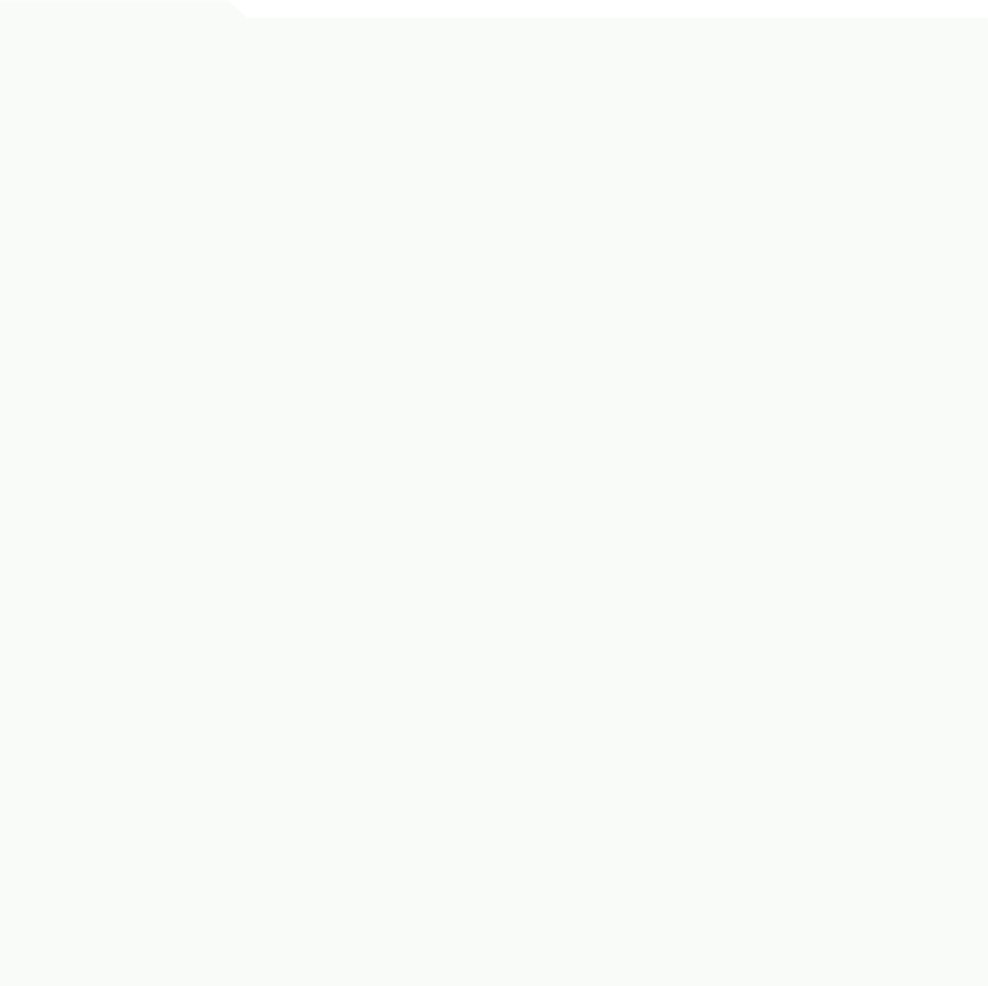


ELVIE FRAMI
STORE MANAGER
WORK BACKGROUND
PERSONAL SUMMARY
BAKS Clothing Company
I'm an experienced store manager with a keen eye for trends and a passion for the retail industry. I put customer satisfaction first, always.
Branch Manager | October 2015-present
Fully accountable for all in-store operations
Provides clear leadership to the sales team
Works hard to ensure that all store and company sales targets are met
FIELDS OF EXPERTISE
Cotton Cameras, Inc.
Merchandising
Customer Service
Leadership
Resolving Customer Complaints
Staff Management
Sales Development
Density Analysis
Inventory Control
Store Manager | July 2014-September 2015
Ensured a high standard of customer service
Analyzed sales figures and made inventory forecasts.
Planned marketing events and promotions for the store.
TRAINING HISTORY
ACHIEVEMENTS:
Beechtown Central College
Branch Manager of the Year, 2015 & 2016
Best Team Leader (peer reviewed), 2014 & 2015
Recognition for Initiative & Foresight, 2014
Most Promising Recruit, 2014
Bachelor's Degree in Hospitality | 2012
- Graduated with a major in hospitality management and a minor in retail management
- Final GPA: 3.02
- Awardee for Best Intern and Outstanding Student Leader
University of Menako
CONTACT DETAILS
Diploma in Sales Management | 2014
Address: 123 Anywhere St., Any City, State, Country 12345
Phone: (123) 456-7890
Email: mail@domain.ltd
Website: domain.ltd
- Completed a diploma course in sales management and operations
- Interned at Cotton Cameras as part of the program and subsequently got hired

