Slide 1


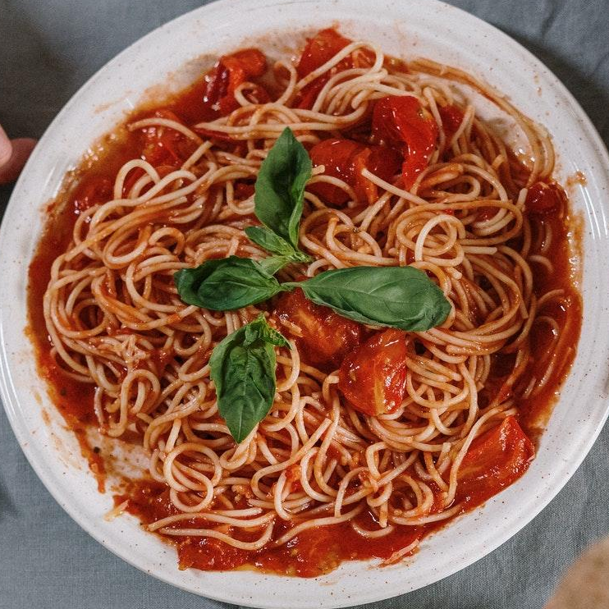








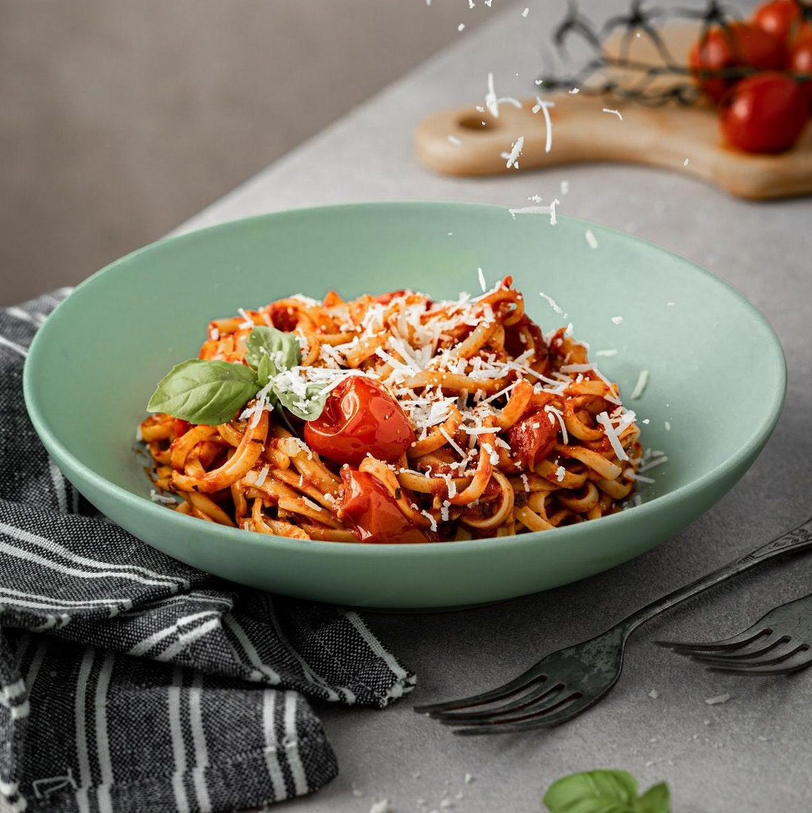
Menu
Italian Restaurant
Pizza
Pasta
Suspendisse.........................12.35$
Gravida..................................4.35$
Suspendisse nec felis auctor neque dignissim pulvinar et ac tortor.
Suspendisse nec felis auctor neque dignissim pulvinar et ac tortor.
Posuere.................................11.45$
Felis........................................6.45$
Vivamus malesuada purus at justo elementum accumsan eu mattis eros.
Quisque faucibus metus vel velit accumsan, in pharetra massa ullamcorper.
Pulvinar.................................8.50$
Pharetra................................4.50$
Maecenas nec lorem pellentesque, sollicitudin tortor sed, pellentesque lectus.
Suspendisse maximus arcu nec urna scelerisque, id varius mauris hendrerit.
Maecenas................................7.15$
Commodo..............................8.15$
Aenean in mauris ac arcu malesuada fringilla in sit amet sapien.
Nulla rhoncus lorem vel urna feugiat, at suscipit leo vehicula.
Suspendisse..........................8.35$
Massa......................................7.35$
Etiam porttitor lectus in erat ultricies, ut efficitur magna pharetra.
Suspendisse nec felis auctor neque dignissim pulvinar et ac tortor.
Venenatis.............................12.45$
Sodales..................................8.45$
Fusce porta libero vitae ligula bibendum, id dignissim lorem rutrum.
Quisque faucibus metus vel velit accumsan, in pharetra massa ullamcorper.
Lacus....................................15.50$
Quisque id sem sit amet lectus consectetur porta sit amet a erat.
Pellentesque..........................9.15$
In posuere purus in urna ullamcorper, sed mattis turpis bibendum.
Tincidunt...............................8.35$
Vivamus in odio ac augue sodales fermentum quis ac neque.

Slide 2
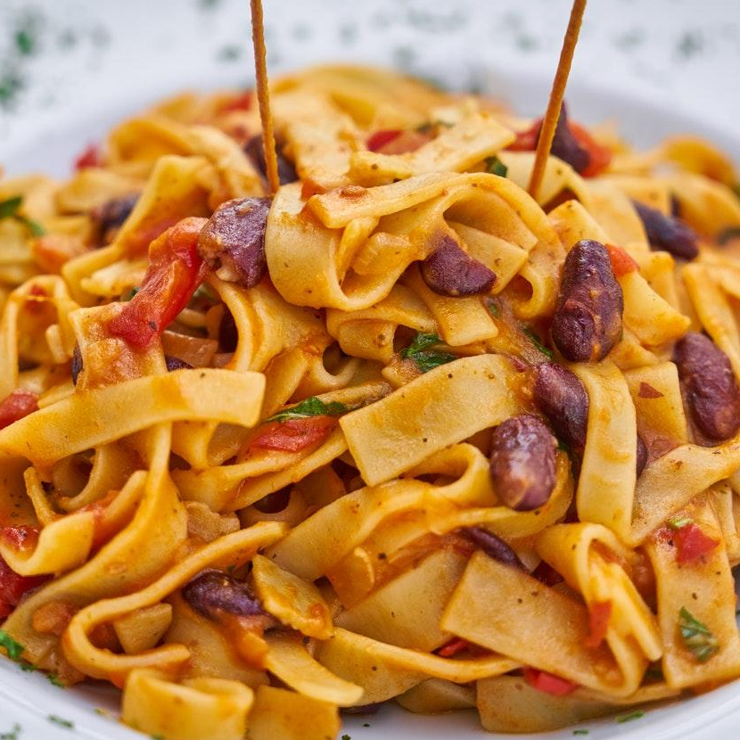

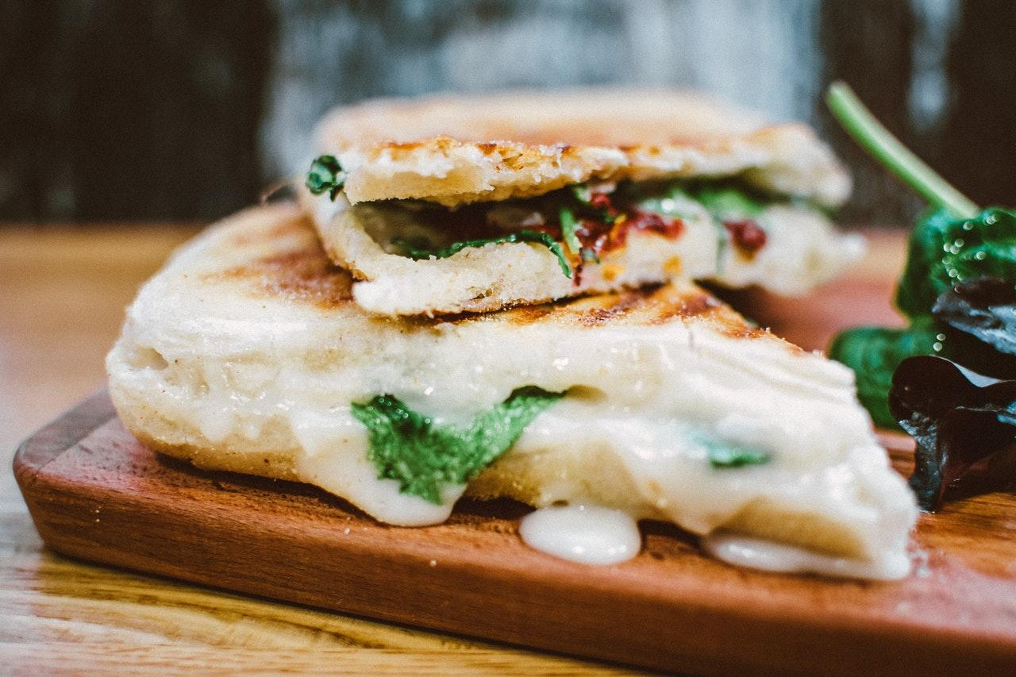
Panini
Curabitur...............................4.35$
Maecenas semper orci nec ex auctor, sit amet gravida leo imperdiet.
Felis........................................5.45$
Quisque faucibus metus vel velit accumsan, in pharetra massa ullamcorper.
Tortor.....................................5.50$
Suspendisse condimentum orci non purus aliquet interdum.
Lobortis..................................4.15$
Special
Nulla rhoncus lorem vel urna feugiat, at suscipit leo vehicula.
Maecenas..............................4.35$
Etiam imperdiet risus nec tellus lacinia, nec dapibus lorem ornare.
Suscipit.................................5.45$
Quisque faucibus metus vel velit accumsan, in pharetra massa ullamcorper.
Viverra..................................5.50$
Suspendisse laoreet velit aliquam, pulvinar turpis quis, suscipit est.
Salads
Malesuada............................4.15$
Nulla rhoncus lorem vel urna feugiat, at suscipit leo vehicula.
Suspendisse...........................4.35$
Commodo.............................4.15$
Vivamus vel odio lobortis sapien iaculis tincidunt at sit amet risus.
Nulla rhoncus lorem vel urna feugiat, at suscipit leo vehicula.
Felis........................................5.45$
Dessert
Quisque faucibus metus vel velit accumsan, in pharetra massa ullamcorper.
Pulvinar.................................5.50$
Suspendisse.........................4.35$
Ut quis metus elementum, gravida mauris vehicula, imperdiet ipsum.
Suspendisse nec felis auctor neque dignissim pulvinar et ac tortor.
Commodo..............................4.15$
Felis.......................................5.45$
Nulla rhoncus lorem vel urna feugiat, at suscipit leo vehicula.
Quisque faucibus metus vel velit accumsan, in pharetra massa ullamcorper.

