Slide 1
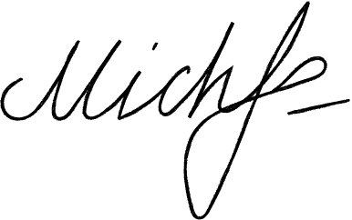



Michelle Lindon
Registration Letter
February 18, 2026
Leanna Kirlin
Lead Researcher
Facilisis Luctus Industries
4549 Alexandre Crest Suite 092, CA 6095
+012-345-67890
To Ms. Kirlin:
Kindly accept this letter as my formal resignation as a staff member of Salem Court Industries. My last day is expected to be on January 19, 2025.
I am incredibly grateful for the opportunities that I have been given in this post. I value the insights that I have learned, and I expect them to help me in my future endeavors. I would also like to thank you for being supportive of my professional growth. I have enjoyed working with you and the rest of the team.
Let me know how I can help in making the transition of responsibilities as seamless as possible for everyone involved. Thank you.
Best wishes,
Michelle Lindon
+012-345-67890
@gdoc.io
hello@gdoc.io

