Slide 1
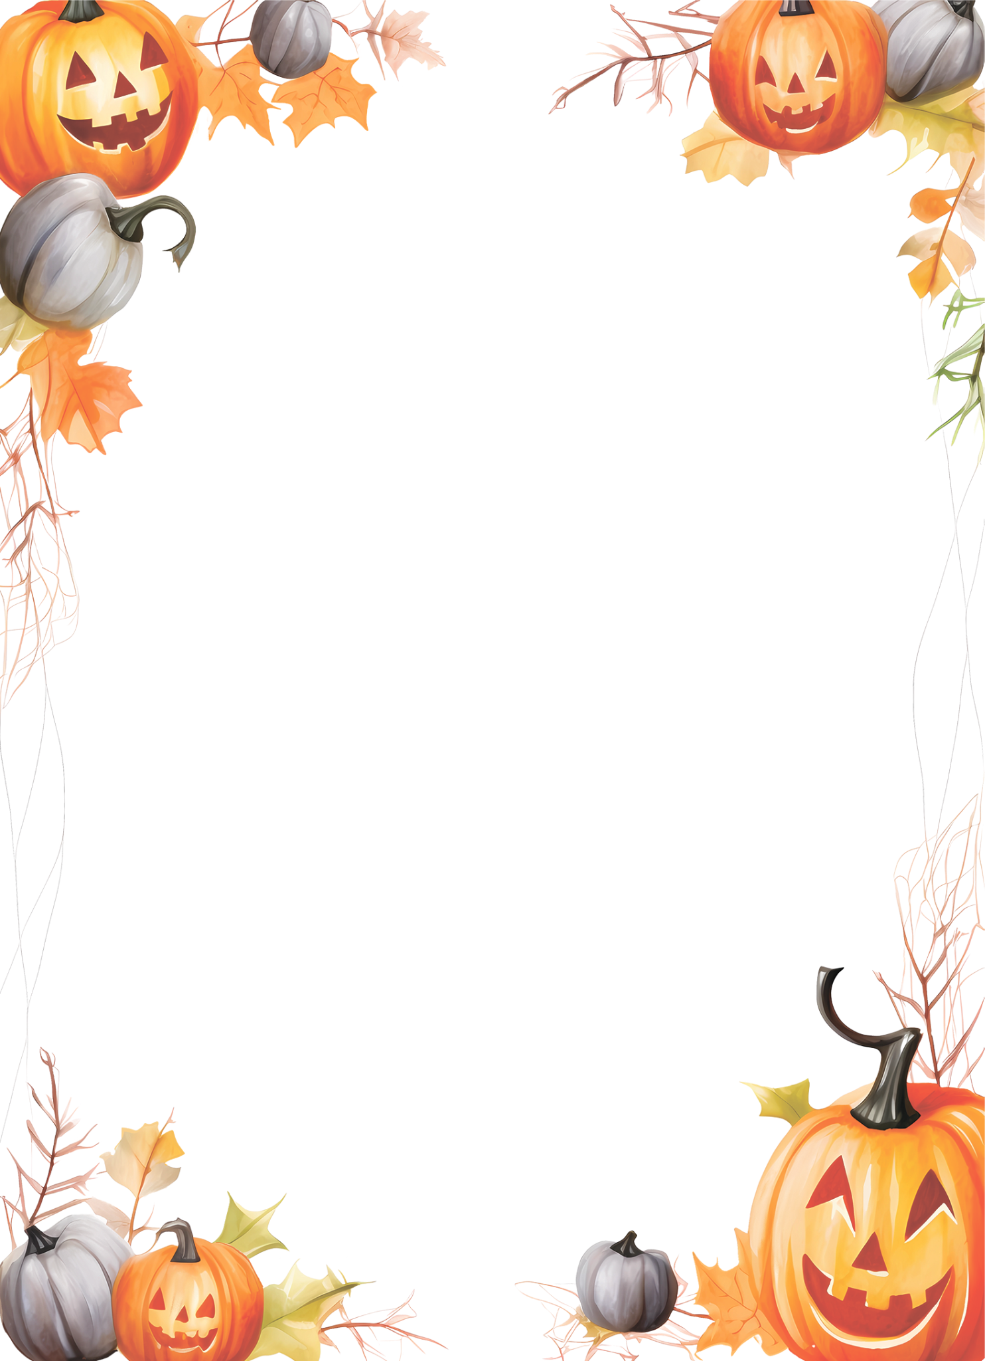




YOU’RE INVITED TO A
Spooky
Party
OCTOBER 31ST, AT 8PM
123 Main Street, Suite 456, Cityville
RSVP TO MARIE
233.345.44.44

