Slide 1
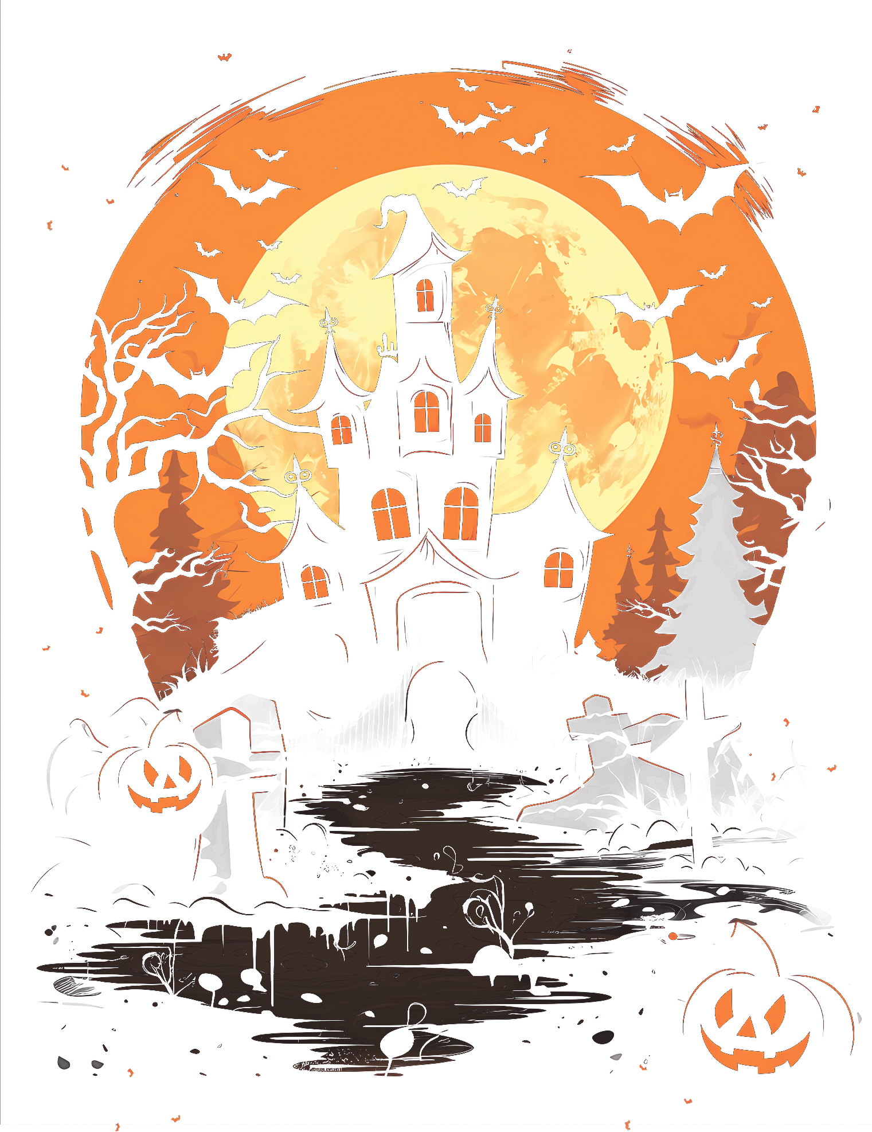

join us for a
HALLOWEEN
PARTY
FRIDAY | OCTOBER 31ST | 8PM
YOU ARE INVITED TO OUR HALLOWEEN PARTY
123 MAIN STREET, SUITE 456, CITYVILLE, STATELAND
Come hungry and thirsty, as we'll have a selection of
devilishly delicious treats and drinks.
RSVP TO MARIE - 233.345.44.44

