Slide 1



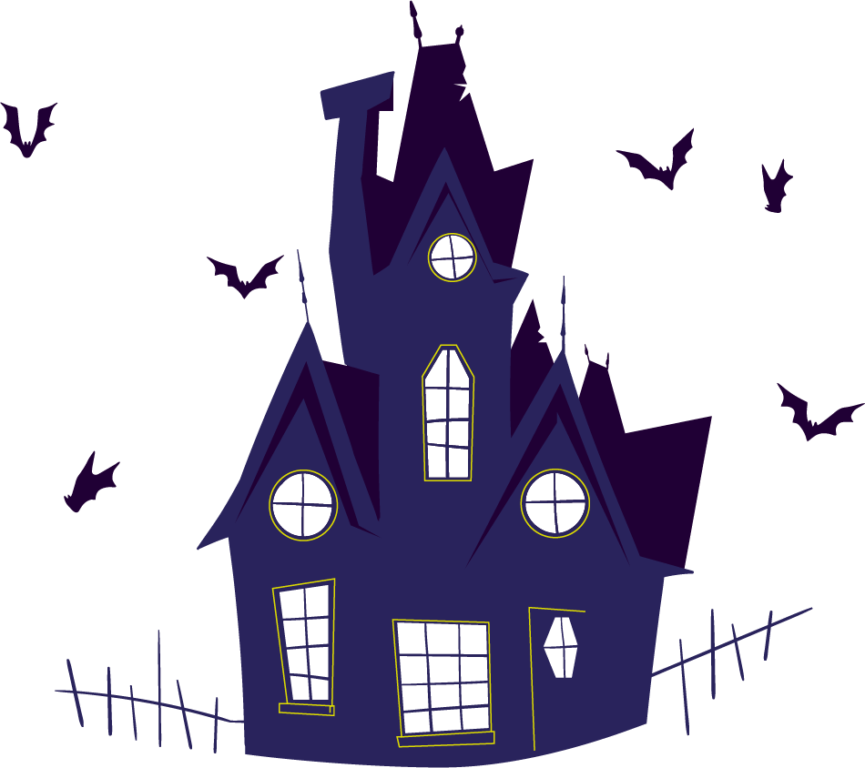
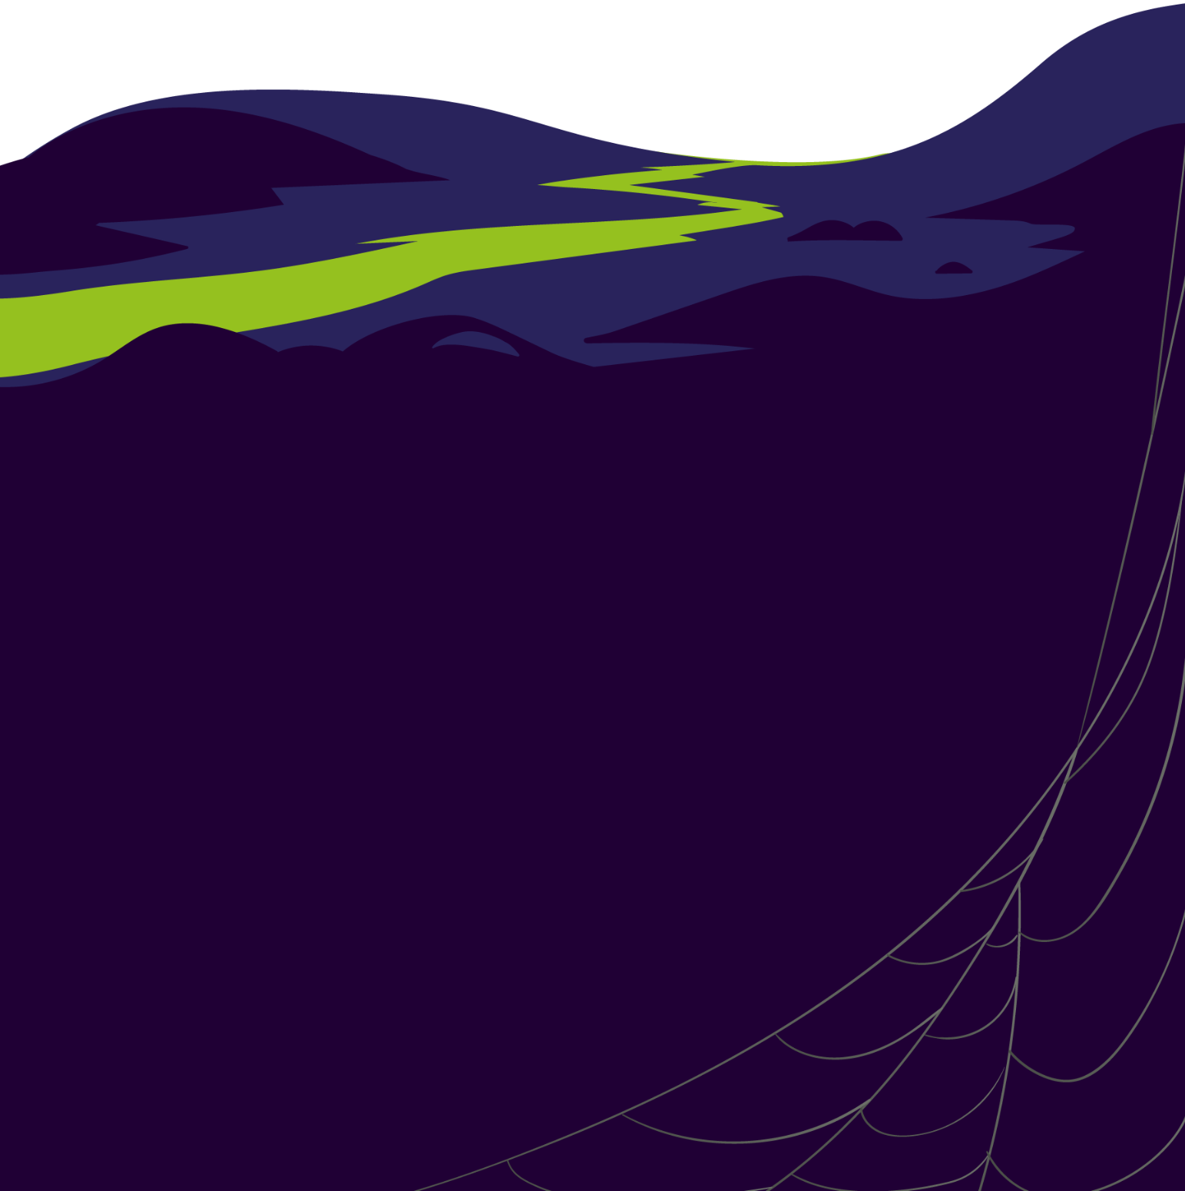


Halloween
Sales
50% OFF
USE CODE: MONSTERS
THE Jacket OF FRANKENSTEIN
THE HAT OF
THE WITCH
Take them before monsters do and be the best version of yourself this HALLOWEEN

