Slide 1
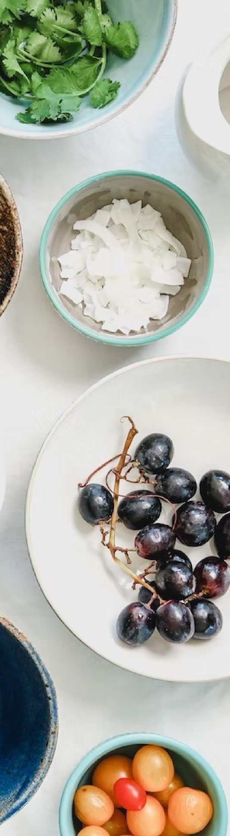
GROCERY LIST FOR THE WEEK
Fruits & Veggies:
Meat & Fish:
Beverages:
Snacks:
Other Food Items:
Toiletries:
Kitchen Needs:
Household Supplies

