Slide 1
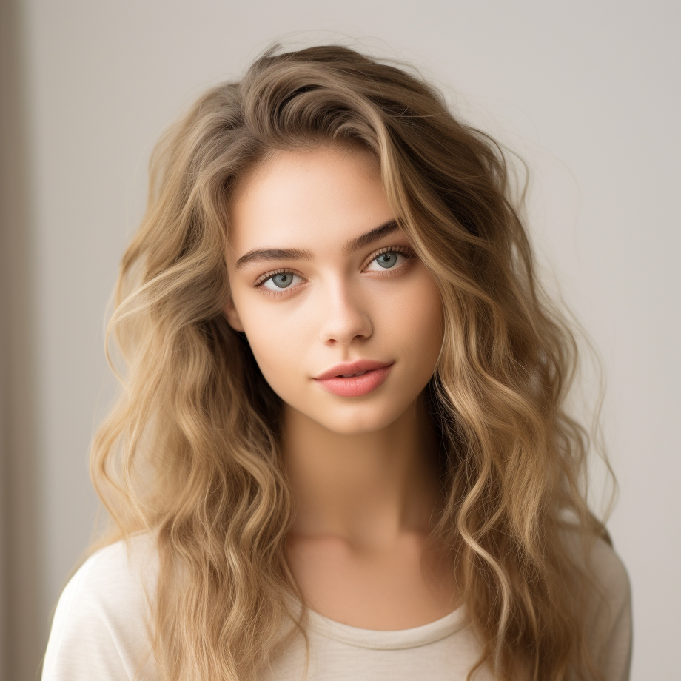
JANE DOE
Graphic Designer
CONTACT
OBJECTIVE
Location:
Highly creative and detail-oriented Graphic Designer with a passion for visual storytelling and brand development. Seeking to leverage my expertise in graphic design to contribute to the success of a dynamic organization.
123 Main Street, City, State
Phone:
(123) 456-7890
Email:
SKILLS
janedoe.design@email.com
Proficient in Adobe Creative Suite (Photoshop, Illustrator, InDesign)
EDUCATION
Strong understanding of typography, color theory, and layout design
Bachelor of Fine Arts
Ability to conceptualize and execute innovative design solutions
in Graphic Design
Experience in branding, logo design, and marketing materials
XYZ University, City, State
Graduated: May 20XX
Knowledge of print and digital design best practices
PORTFOLIO
EXPERIENCE
Link to online portfolio:
GRAPHIC DESIGNER ABC Design Agency
www.janedoeportfolio.com
January 20XX - Present
Collaborated with clients to conceptualize and create custom designs for branding, marketing collateral, and digital assets
REFERENCES
Produced engaging visual content for social media, websites, and email campaigns
Available upon request.

Slide 2
JANE DOE
Graphic Designer
CONTACT
EXPERIENCE
Location:
GRAPHIC DESIGNER DEF Marketing Firm
123 Main Street, City, State
June 20XX - December 20XX
Phone:
Assisted senior designers in the development and execution of various design projects
(123) 456-7890
Contributed creative ideas and solutions during brainstorming sessions
Email:
Prepared print-ready files and communicated with vendors to ensure quality production
janedoe.design@email.com
Conducted research on industry trends and competitor analysis to inform design strategies
EDUCATION
Bachelor of Fine Arts
GRAPHIC DESIGNER GHI Creative Studio
in Graphic Design
March 20XX - January 20XX
XYZ University, City, State
Led a team of designers in the creation of comprehensive brand identities, including logos, style guides, and visual assets
Graduated: May 20XX
Developed innovative design concepts and presented proposals to clients, resulting in increased satisfaction and repeat business
PORTFOLIO
Link to online portfolio:
Conducted client meetings to gather requirements, provide updates, and obtain feedback throughout the design process
www.janedoeportfolio.com
Mentored junior designers, providing guidance on design techniques, software proficiency, and project management skills
REFERENCES
Contributed creative ideas and solutions during brainstorming sessions
Available upon request.

Slide 3
JANE DOE
Graphic Designer
CONTACT
Dear Laura Johnson,
Location:
I am writing to express my interest in the [Position Title] position advertised by [Company/Organization Name]. With a Bachelor of Fine Arts in Painting and Sculpture from the Art Institute of Creativity and a Master of Fine Arts in Multimedia Art from Contemporary Art College, along with extensive experience in various artistic mediums, I am excited about the opportunity to contribute to your team.
Throughout my career, I have participated in numerous exhibitions, both solo and group shows, where I have been able to showcase my creativity and versatility as an artist. These experiences have not only honed my technical skills but have also taught me the importance of effective communication and collaboration in the artistic process.
I am particularly drawn to [Company/Organization Name] because of its commitment to [mention any specific initiatives, values, or projects of the company/organization that resonate with you]. I am eager to bring my skills and experiences to your team and contribute to the continued success of your organization.
Thank you for considering my application. I look forward to the opportunity to discuss how my background, skills, and passion for art align with the needs of [Company/Organization Name]. Please find my resume attached for your review.
123 Main Street, City, State
Phone:
(123) 456-7890
Email:
janedoe.design@email.com
Laura Johnson
Location:
56 Main Street, City, State
Phone:
(678) 789-3458
Email:
Warm regards,
laura.johnson@email.com
Jane Doe

Slide 4
JANE DOE
Graphic Designer
CONTACT
REFERENCES
Location:
Amanda Carter
123 Main Street, City, State
Position: Director of Engagement
Phone:
Company: Creative Minds Foundation
(123) 456-7890
Phone: (555) 678-9012
Email: amanda.carter@creative.com
Email:
Laura Patel
janedoe.design@email.com
Position: Gallery Assistant
Company: Unity Gallery
Phone: (555) 890-1234
EDUCATION
Email: Laura.patel@design.com
Bachelor of Fine Arts
Daniel Ramirez
Position: Lead Artist
in Graphic Design
Company: Spectrum Art Studios
XYZ University, City, State
Phone: (555) 789-0123
Graduated: May 20XX
Email: daniel.ramirez@spectrumart.com
Jessica Nguyen
Position: Art Collector
PORTFOLIO
Company: Spectrum Art Studios
Phone: (555) 012-3456
Link to online portfolio:
Email: jessica.nguyen@example.com
www.janedoeportfolio.com

