Slide 1

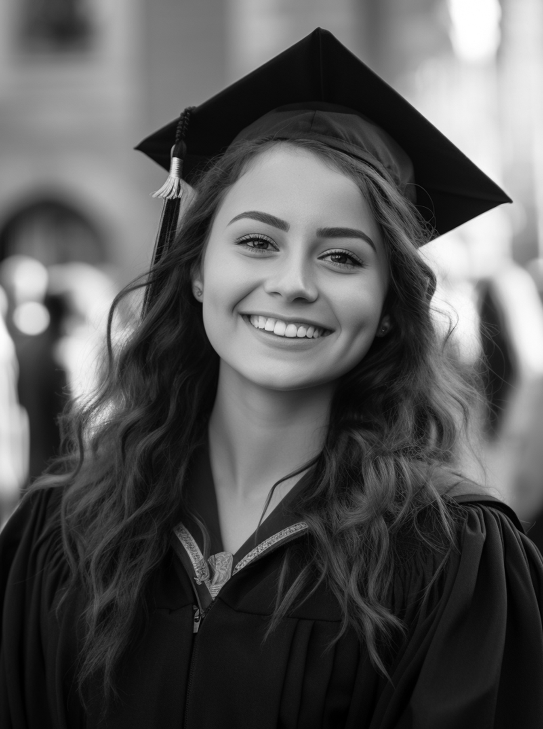
CLASS OF
Emily Johnson
2025
You're invited to toast
Emily Johnson and
the Princeton Class of 2025
At the Luxury hotel
Tuesday, July 1st at 2 P.M.

