Slide 1
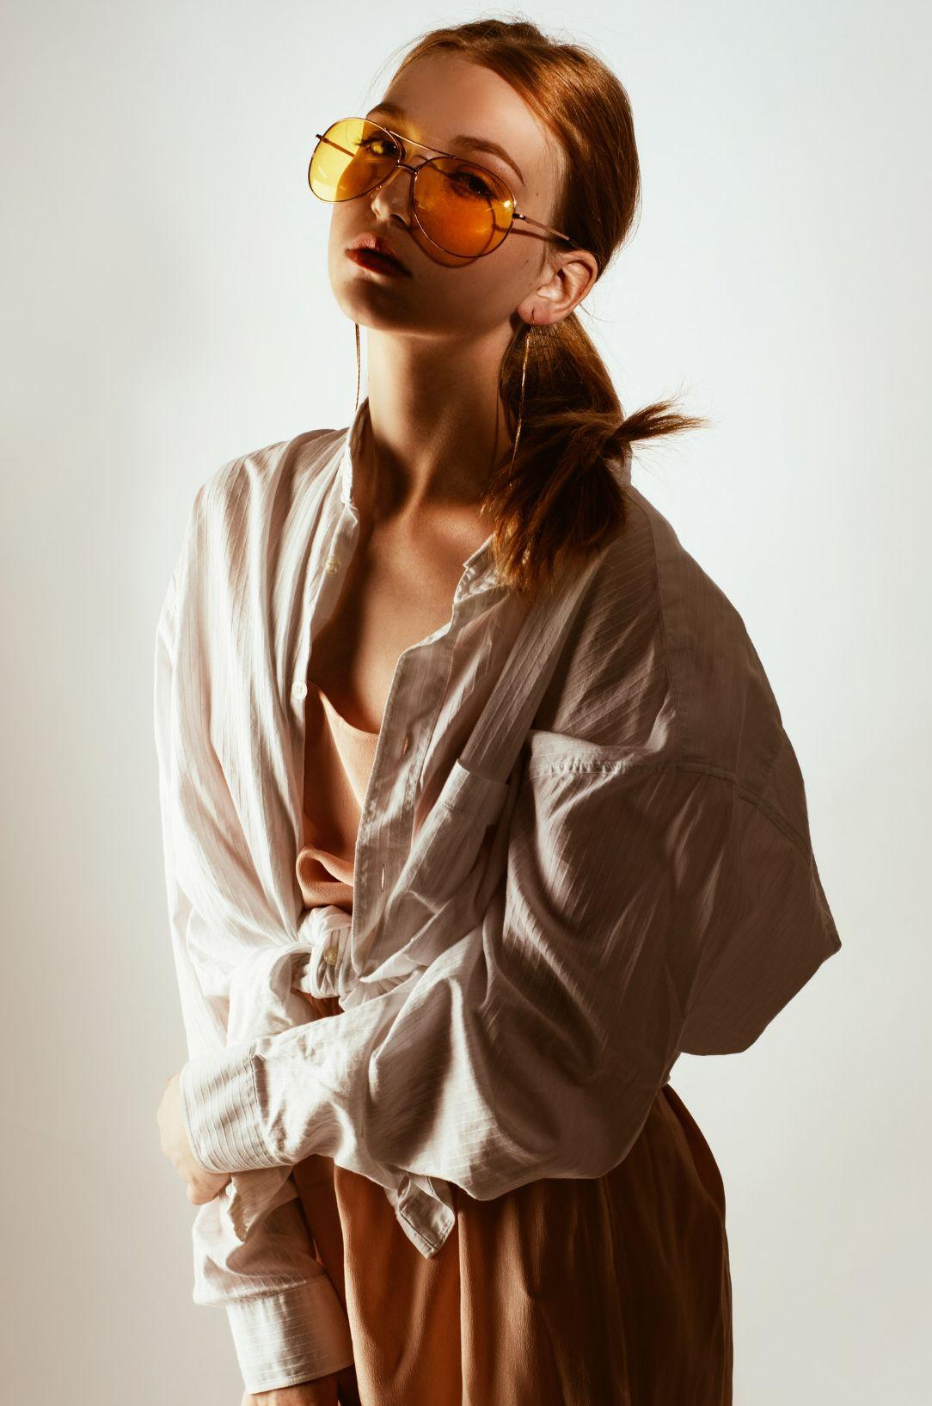


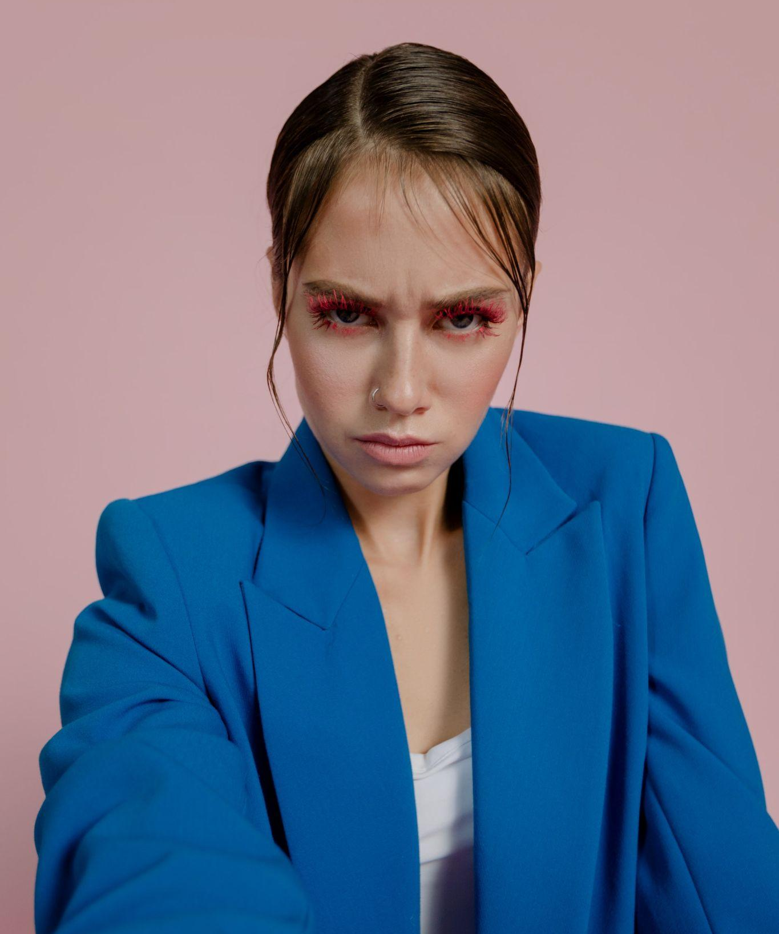



May 2025 Issue №2 | Example.com
Fashion Email Newsletter
Etiam erat tortor
Elementum tellus
Pellentesque sagittis
Read more
Read more
Read more
Join The
Community
Nulla pulvinar libero neque, a suscipit velit rutrum sit amet. Vivamus hendrerit commodo purus, at varius arcu ullamcorper non. Maecenas maximus.
Join now
facebook.com/example
instagram.com/example
twitter.com.com/example

Slide 2
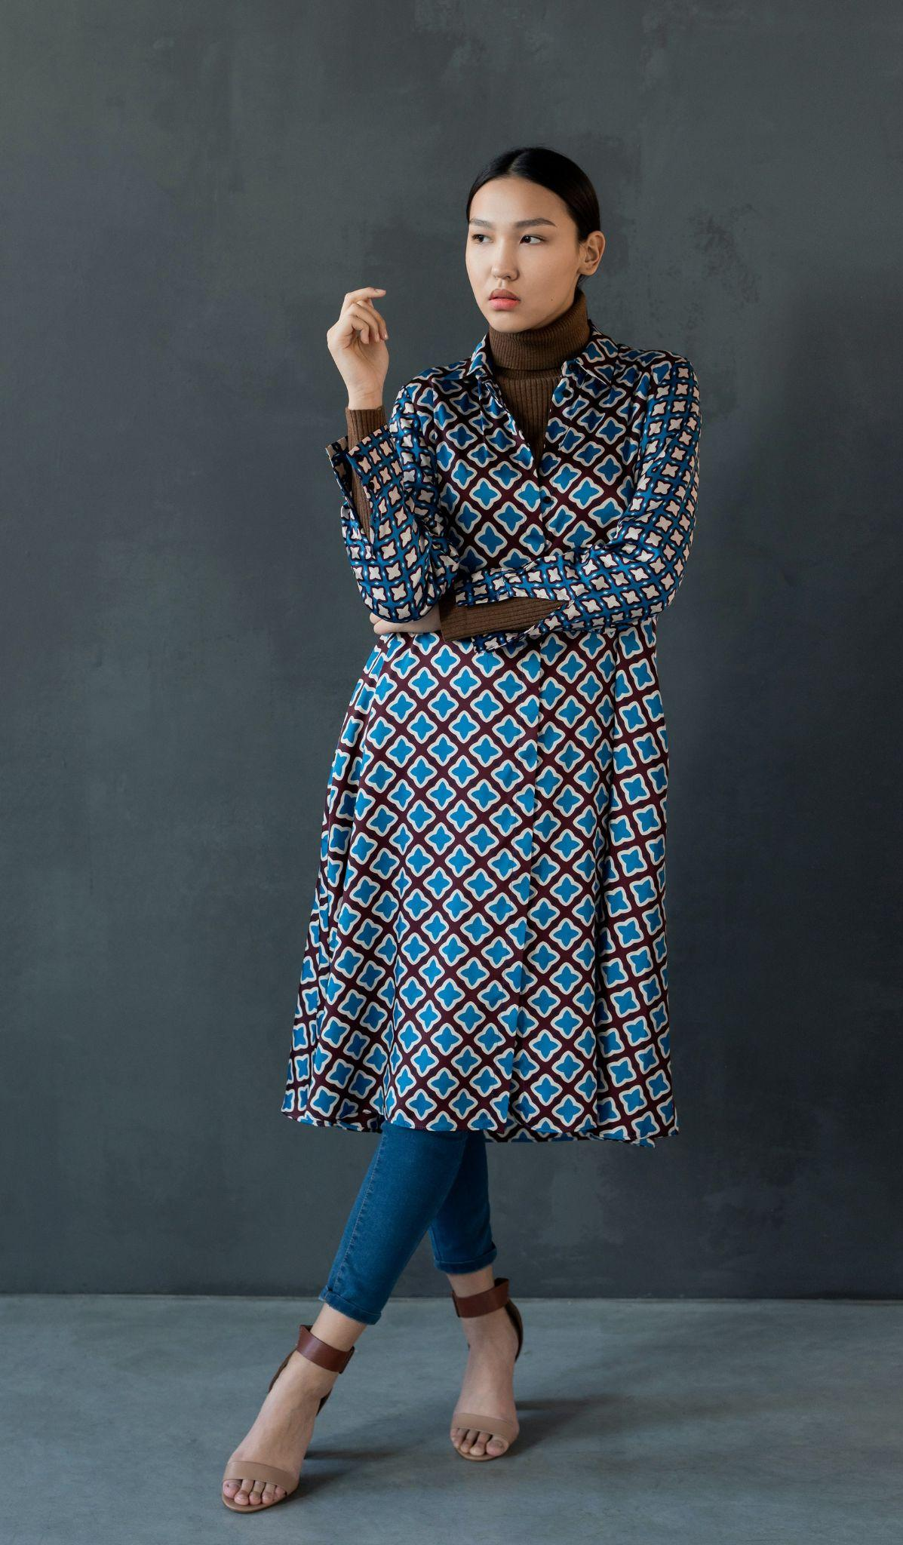

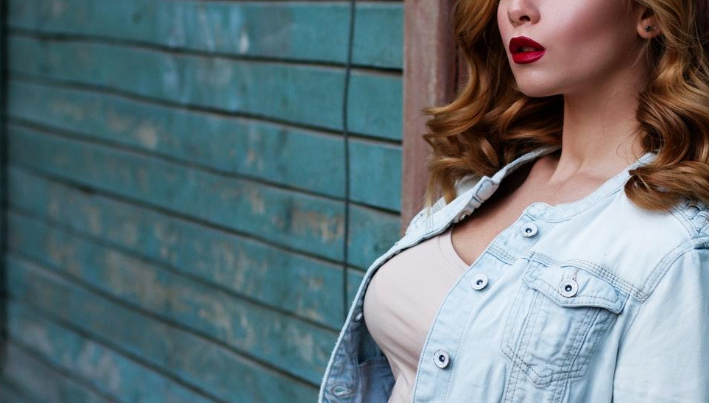
New collection
Pellentesque erat nisi, aliquet ac sem ut, sollicitudin tincidunt leo. Vestibulum id massa dignissim turpis tempus laoreet. Quisque sollicitudin nibh vel lectus.
Discover
25% OFF
Suspendisse eleifend euismod lacus. Nam mollis placerat nibh, et congue purus rhoncus quis. Maecenas pharetra eu lorem sit amet accumsan. Praesent eu dui augue.
Shop now

