Slide 1

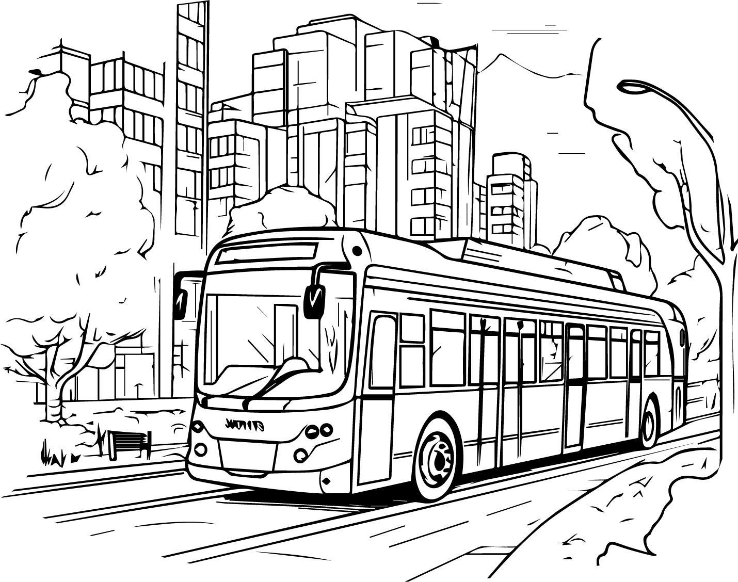
Customizable Packing List
Days:
Destination:
Weather:
Note:
Toiletries
Clothes Formal
Miscellaneous
Face Wash
Suits
House Keys
Glasses
Skirts
Snacks
Tooth Paste
Dress Shirts
Books / Magazines
Perfume / Cologne Gel
Ties
Water Bottles
Shampoo
Pants
Travel Guide
Feminine Products
Blouses
First AID Kit
Makeup Kit
Dresses
Shoes
Hair Products
Health / Medical
Cotton Buds
Boots
Body Wash / Soap
Insect Repellent
Running Shoes
Night Guard
Sanitizer
Slippers / Flip Flops
Hair Brush / Comb
Sunscreen
Casual Shoes
Deodorant
Medications
Dress Shoes
Tooth Brush
Prescriptions
Sandals
Dental Floss
Vitamins
Gadgets
Tissues / Wipes
Pain Reliever
Moisturizer / Body Lotion
Batteries
Shaver Razor
Documents
USB Sticks
Shaving Cream / Gel
Itinerary
Camera
Contact Lens / Case
Hotel Reservation Info
Tablet / E-Reader
Contact Lens Solution
Emergency Contacts
Cell Phone
Conditioner
Frequent Flyer
Laptop
Clothes Essentials
Passport / Visa
Headphones
Socks
Travel Insurance
Chargers
Robe
Transportation info
Converter
Underwear
Travel Tickets
I PODs / Music Players
Bras
Driver License / ID
Clothes Casual
Boxers
Financials
Swimsuit
PJS / Sleepwear
Credit Cards
Workout Clothes
Accessories
Cash
Jeans
Belts
ATM / Debit Cards
Shirts / T-Shirts
Sun Glasses
Shorts
Jewellery
Capris

