Slide 1
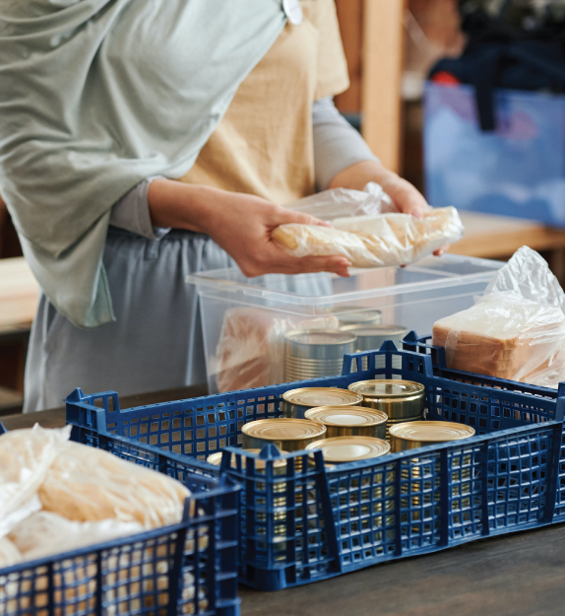
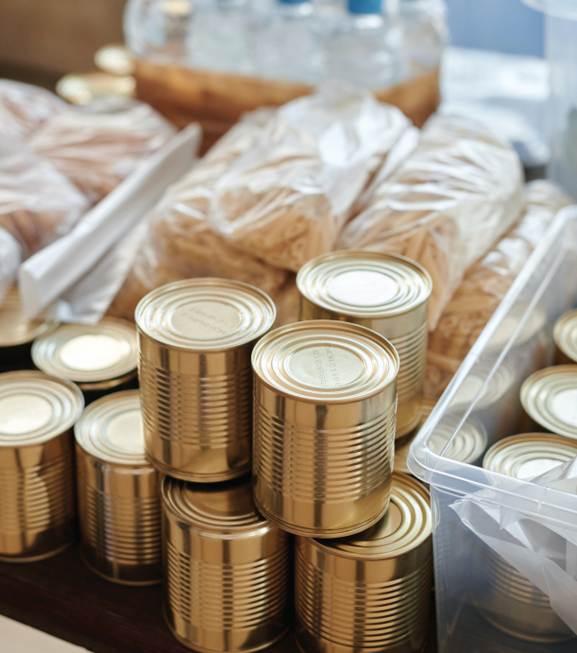
Join the Campaign
FOOD DRIVE
People Should
Help Each Other!
Food is a human right and is an immediate and tangible way to help someone, every donation of
food can make a difference.
October 6, 2025
Most Needed Items:
Canned fish, canned corn, beans,
canned meat, chicken, pork,
beef, canned asparagus.
Drop Location:
123 Anywhere st., Any City,
Louisiana, 33131
Contact: +1 123-456-7890
example@mail.ltd
www.yourwebsite.ltd

