Slide 1



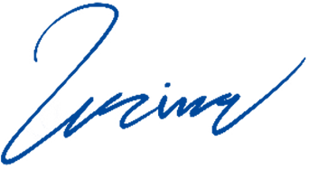
COREFUSION
Powering Possibilities, Fusing Futures
To:
Alex Turner
23 Main Street, Suite 6
Cityville, Stateland, ZIP123
07/07/2030
Dear Alex Turner,
I hope this letter finds you well. I am writing on behalf of [Your Company Name], a leader in the [your industry or field] sector. It is my pleasure to introduce our company and explore potential opportunities for collaboration with [Recipient's Company Name].
At [Your Company Name], we are dedicated to [briefly describe your company's mission or key services/products]. With a team of highly skilled professionals and a commitment to excellence, we have successfully [mention any notable achievements, projects, or partnerships]. Our goal is to [explain your company's overarching goal or vision].
I would love to explore these opportunities further and discuss how our collaboration could be mutually beneficial. If you are available, I would be honored to schedule a meeting at your convenience. Please feel free to reach out to me via email at [Your Email Address] or by phone at [Your Phone Number]. Thank you for considering this proposal. We look forward to the possibility of working together and contributing to each other's success.
Best regards,
Emily Reynolds
Chief Executive Officer
Phone: +1 (555) 987-4567
Email: emily@company.ltd
Web: www.corefusion.ltd

